Slide 1
Analyzing the Impact of Sleep and Lifestyle Factors on Stress Levels Using ML
By:
Nithyasree N
Sujith Ram V

Slide 2
PROBLEM STATEMENT AND OBJECTIVE
Predictive Modeling of Sleep Quality and Stress Architecture: Assessing Interdependencies between Lifestyle, BMI, and Cardiovascular Metrics.
The objective of this project is to investigate how lifestyle factors and physiological measurements influence stress levels.
. The project utilizes machine learning techniques to identify significant predictors of stress and evaluate their relationships with sleep quality and cardiovascular health.

Slide 3


DATASET
Category | Examples
Sleep | Sleep Duration, Quality of Sleep
Lifestyle | Daily Steps, Physical Activity
Health | Heart Rate, Blood Pressure, BMI
Target | Stress Level
Source: Kaggle
Number of Records: 374
Number of features:13

Slide 4
PROJECT workflow
Dataset Collection
Dataset Preprocessing
EDA
Model Building
Model Evaluation
Feature Importance
Result

Slide 5
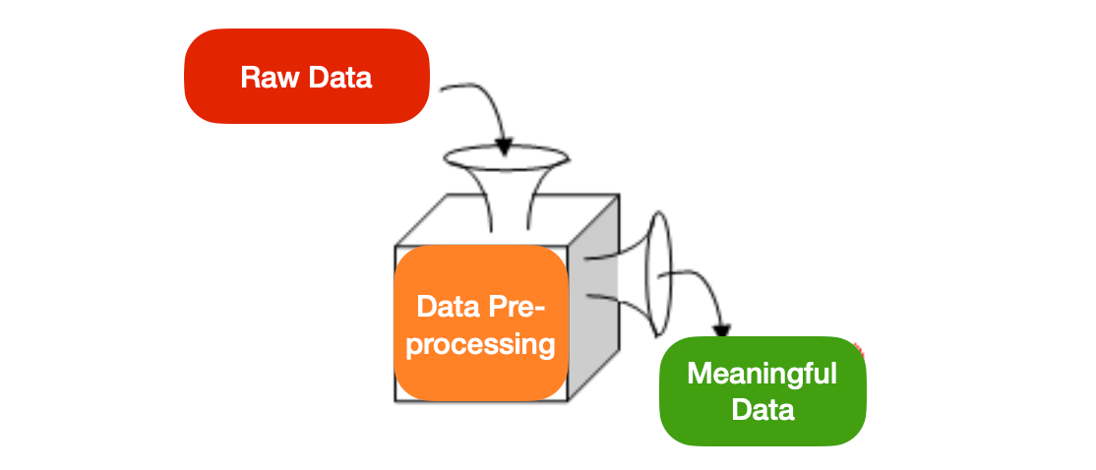
Data preprocessing
Removal of Irrelevant Attributes
Handling Missing Values
Categorical Variable Encoding
Feature and Target Selection
Train-Test Split

Slide 6
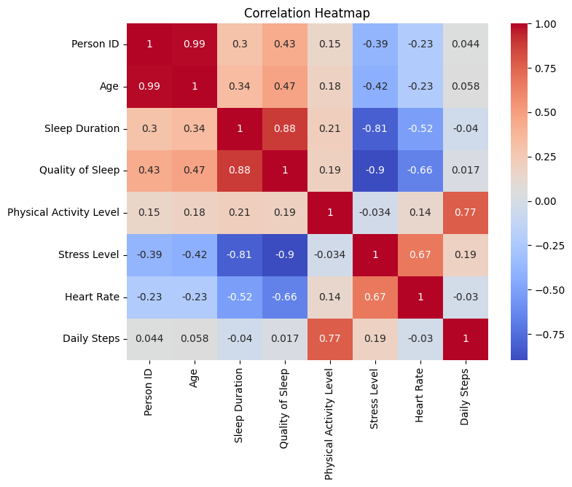
Exploratory data analysis
CORRELATION HEATMAP
To identify relationships among the variables in the dataset and determine which factors are most strongly associated with stress levels.
Correlation coefficients range from -1 to +1.
Values closer to +1 indicate a strong positive relationship.
Values closer to -1 indicate a strong negative relationship.
Values near 0 indicate little or no relationship.

Slide 7
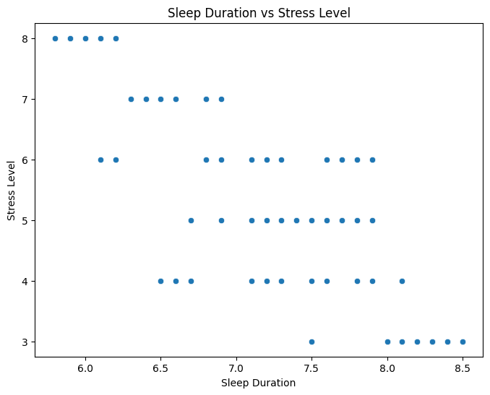
SLEEP DURATION VS STRESS
The scatter plot shows a clear negative relationship between Sleep Duration and Stress Level.
Individuals with shorter sleep durations (approximately 5.8–6.5 hours) generally exhibit higher stress levels (6–8)
Whereas individuals who sleep for longer durations (approximately 7.8–8.5 hours) tend to have lower stress levels (3–4).

Slide 8
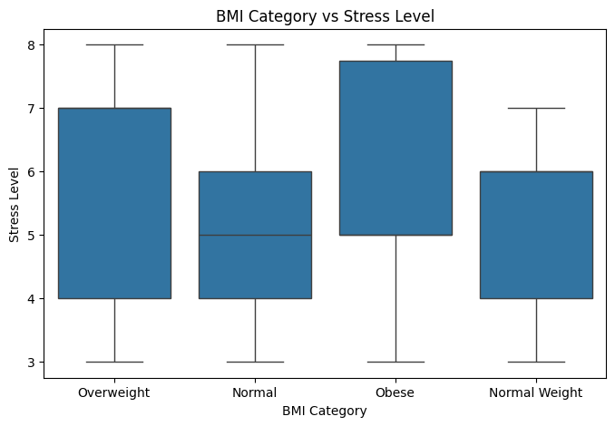
BMI vs STRESS
The box plot reveals that stress levels vary across BMI groups.
The Obese category exhibits relatively higher median stress levels and a wider spread compared to other categories.
Normal Weight individuals generally display lower and more consistent stress levels.

Slide 9
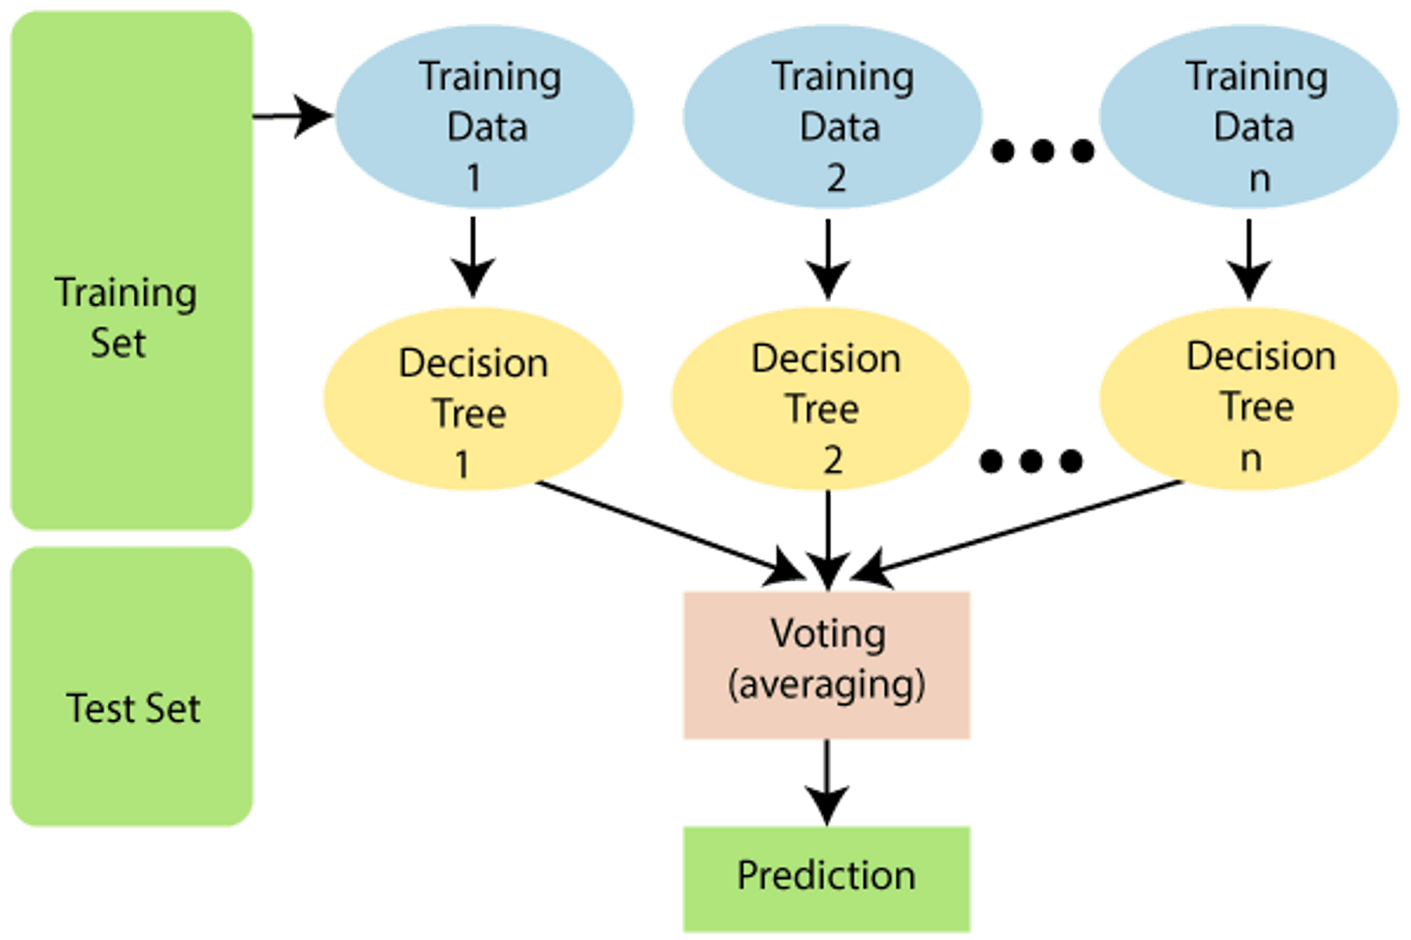
Machine learning model development
Logistic Regression:
Baseline classification model due to its simplicity and computational efficiency.
Uses Probabilistic approach
Decision tree:
Models nonlinear relationships among the predictor variables.
The model generates a hierarchical structure of decision rules based on feature values.
Random Forest:
Ensemble learning algorithm that combines multiple decision trees and aggregates their predictions through a voting mechanism.
This approach improves robustness and reduces overfitting.

Slide 10
Model results
Model | Accuracy (%)
Logistic Regression | 86.67
Decision Tree | 97.33
Random Forest | 100.00

Slide 11
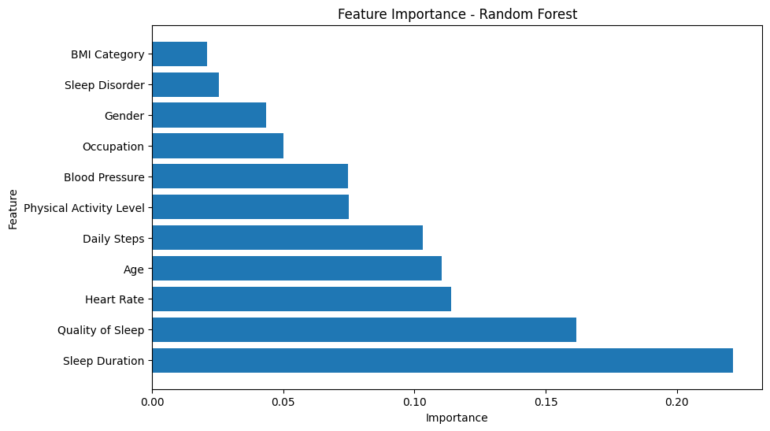
Feature importance
Feature | Importance
Sleep Duration | 0.221510
Quality of Sleep | 0.161708
Heart Rate | 0.113826
Age | 0.110289
Daily Steps | 0.103252
Physical Activity Level | 0.074992
Blood Pressure | 0.074787
Occupation | 0.049885
Gender | 0.043363
Sleep Disorder | 0.025504
BMI Category | 0.020885

Slide 12
future scopes
Future studies may utilize larger real-world healthcare datasets.
Additional variables such as mental health indicators, dietary habits, and wearable sensor data can be incorporated.
Advanced machine learning and deep learning techniques can be explored for improved prediction performance.
The developed model can be integrated into healthcare monitoring systems for early stress assessment and preventive intervention.

Slide 13


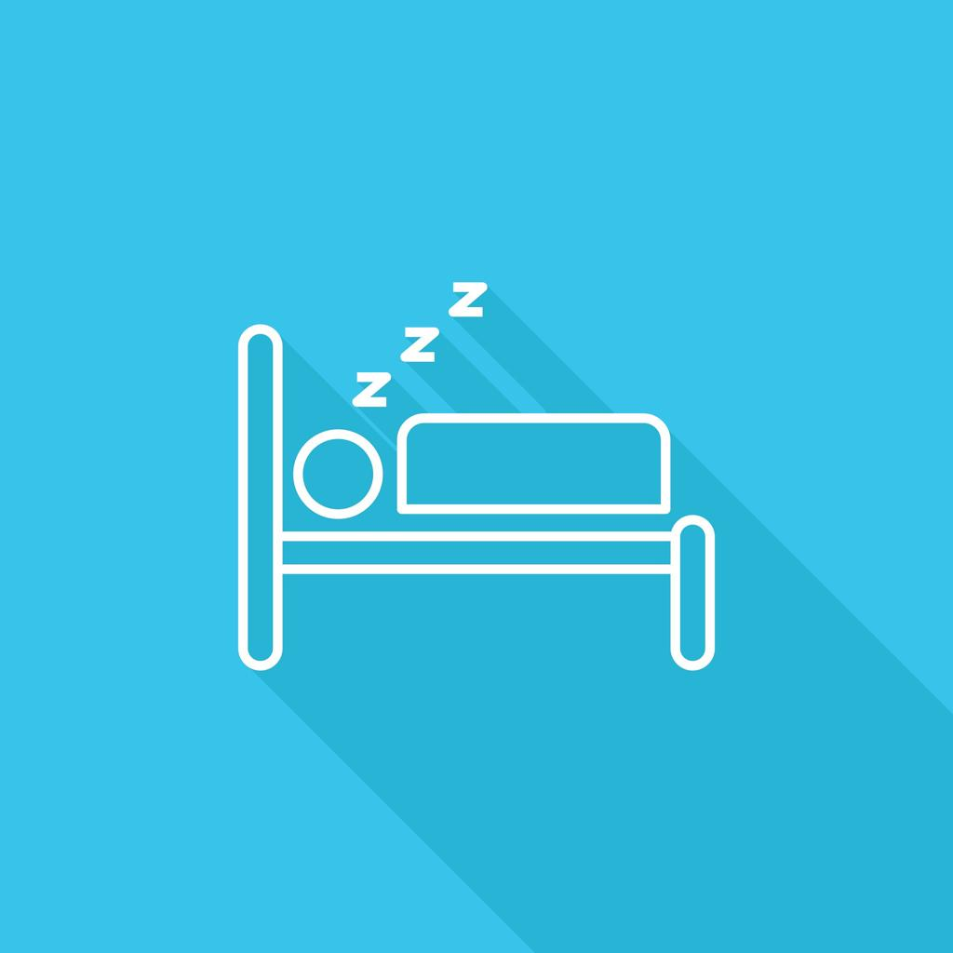
conclusion
Sleep Duration is the strongest predictor.
Random Forest achieved highest accuracy.
Sleep variables play a major role in stress prediction.
Machine Learning can support healthcare analytics.

